Slide 1
Core Java 8 and Development Tools
Lesson 09: Collection

Slide 2
Lesson Objectives
After completing this lesson, participants will be able to
Understand collection framework
Notes:
This lesson discusses about collection framework in Java.
Lesson outline:
9.1: Collections Framework
9.2: Collection Interfaces

Slide 3

9.1: Collections Framework Collections Framework
A Collection is a group of objects.
Collections framework provides a set of standard utility classes to manage collections.
Collections Framework consists of three parts:
Core Interfaces
Concrete Implementation
Algorithms such as searching and sorting
Notes:
Collections Framework:
A Collection (sometimes called a container) is an object that groups multiple elements into a single unit. Collection is used to store, retrieve objects, and to transmit them from one method to another.
The Collections API (also called the Collections framework) standardizes the way in which groups of objects are handled by your programs. It presents a set of standard utility classes to manage such collections. This framework is provided in the java.util package and comprises three main parts:
The core interfaces, which allow collections to be manipulated independent of their implementation. These interfaces define the common functionality exhibited by collections, and facilitate data exchange between collections.
A small set of implementations, which are concrete implementations of the core interfaces, providing data structures that a program can use. Eg LinkedLists, Arrays etc
An assortment of algorithms, which can be used to perform various operations on collections, such as sorting & searching.
The collection classes are the fundamental building blocks of the more complicated data structures used in the other Java packages in your own applications. There are several types of collections. They vary in storage mechanisms used, in the way they access data, and in the rules about what data may be stored.
Note: The Java Collection technology is similar to the Standard Template Library (STL) defined by C++.

Slide 4
9.1: Collections Framework Advantages of Collections
Collections provide the following advantages:
Reduces programming effort
Increases performance
Provides interoperability between unrelated APIs
Reduces the effort required to learn APIs
Reduces the effort required to design and implement APIs
Fosters Software reuse
Notes:
Collections Framework:
Advantages of Collections:
Collections provide the following advantages:
Reduces programming effort by providing useful data structures and algorithms so you do not have to write them yourself.
Increases performance by providing high-performance implementations of useful data structures and algorithms. Since the various implementations of each interface are interchangeable, programs can be easily tuned by switching implementations.
Provides interoperability between unrelated APIs by establishing a common language to pass collections back and forth.
Reduces the effort required to learn APIs by eliminating the need to learn multiple ad hoc collection APIs.
Reduces the effort required to design and implement APIs by eliminating the need to produce ad hoc collections APIs.
Fosters software reuse by providing a standard interface for collections and algorithms to manipulate them.

Slide 5
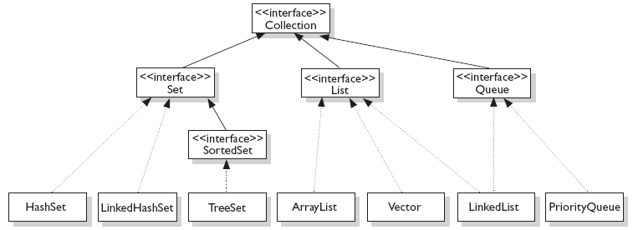
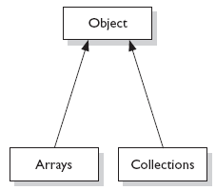
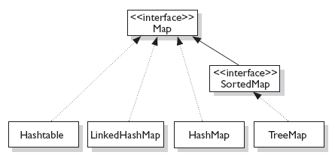


9.1: Collections Framework Concept of Interfaces and Implementation
Fig:1
Fig:3
Fig:2
Notes:
Interfaces and Implementation:
The core collection interfaces (shown in figure above) are the interfaces used to manipulate collections, and to pass them from one method to another. The basic purpose of these interfaces is to allow collections to be manipulated independently of the details of their representation.
Not all collections in the Collections Framework actually implement the Collection interface. Specifically, none of the Map-related classes and interfaces extend from Collection. So while SortedMap, Hashtable, HashMap, TreeMap, and LinkedHashMap are all thought of as collections, none are actually extended from Collection.
Note: Collections is a class, with static utility methods, while Collection is an interface with declarations of the methods common to most collections including add(), remove(), contains(), size(), and iterator().

Slide 6
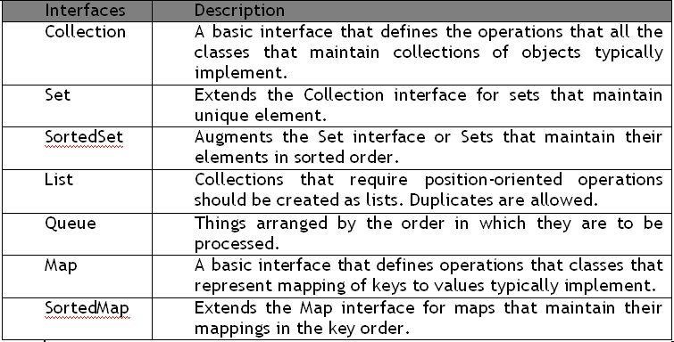
9.2: Collection Interfaces Collection Interfaces
Let us discuss some of the collection interfaces:
Notes:
Interfaces and Implementation:
Collection Interfaces:
Following are the four major interfaces:
Set Interface: holds only unique values and rejects duplicates.
List Interface: represents an ordered list of objects, meaning the elements of a List can be accessed in a specific order, and by an index too. List can hold duplicates.
Queue Interface: represents an ordered list of objects just like a List. However, a queue is designed to have elements inserted at the end of the queue, and elements removed from the beginning of the queue. Just like a queue in a supermarket!
Map Interface: represents a mapping between a key and a value. The Map interface is not a subtype of the Collection interface. A Map cannot contain duplicate keys; each key can map to at most one value. The Map implementations let you do things like search for a value based on the key, ask for a collection of just the values, or ask for a collection of just the keys.
SortedSet Interface: is a Set that maintains its elements in ascending order. Several additional operations are provided to take advantage of the ordering.
SortedMap Interface: is a Map that maintains its mappings in ascending key order. This is the Map analog of SortedSet. Sorted maps are used for naturally ordered collections of key/value pairs, such as dictionaries and telephone directories.

Slide 7
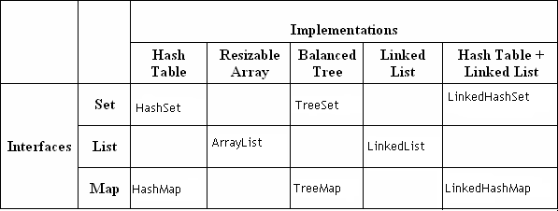
9.2: Collection Interfaces Collection Implementations
Collection Implementations:
Notes:
Collection Implementations:
The Java Collections Framework provides several general-purpose implementations of the Set, List, and Map interfaces. The general purpose implementations are summarized in the table above.
HashSet: is an unsorted, unordered Set. It uses the hashcode of the object being inserted, so the more efficient your hashCode() implementation is, the better access performance you will get. Use this class when you want a collection with no duplicates and you do not care about order when you iterate through it. Implements the Set interface.
LinkedHashSet: differs from HashSet by guaranteeing that the order of the elements during iteration is the same as the order they were inserted into the LinkedHashSet.
TreeSet: implements the SortedSet interface. Like LinkedHashSet, TreeSet also guarantees the order of the elements when iterated, but the order is the sorting order of the elements. This order is determined either by their natural order (if they implement Comparable), or by a specific Comparator implementation.
ArrayList: Think of this as a growable array. It gives you fast iteration and fast random access. It is an ordered collection (by index). However, it is not sorted. ArrayList now implements the new RandomAccess interface — a marker interface (meaning it has no methods) that says, “this list supports fast (generally constant time) random access.” Choose this over a LinkedList when you need fast iteration but are not as likely to be doing a lot of insertion and deletion.
LinkedList: A LinkedList is ordered by index position, like ArrayList, except that the elements are doubly-linked to one another.

Slide 8
9.2: Collection Interfaces Collection Implementations
Notes Page
Notes:
Collection Implementations (contd.):
This linkage gives you new methods (beyond what you get from the List interface) for adding and removing from the beginning or end. This makes it an easy choice for implementing a stack or queue. Keep in mind that a LinkedList may iterate more slowly than an ArrayList. However, it is a good choice when you need fast insertion and deletion. As of Java 5, the LinkedList class has been enhanced to implement the java.util.Queue interface. As such, it now supports the common queue methods: peek(), poll(), and offer().
HashMap: The HashMap gives you an unsorted, unordered Map. When you need a Map and you do not care about the order (when you iterate through it), then HashMap is the way to go. The other maps add a little more overhead. Where the keys land in the Map is based on the key’s hashcode. So, like HashSet, the more efficient your hashCode() implementation, the better access performance you will get. HashMap allows one null key and multiple null values in a collection.
TreeMap: TreeMap is a sorted Map.
LinkedHashMap: Like its Set counterpart, LinkedHashSet, the LinkedHash-Map collection maintains insertion order (or, optionally, access order). Although it will be somewhat slower than HashMap for adding and removing elements, you can expect faster iteration with a LinkedHashMap.

Slide 9
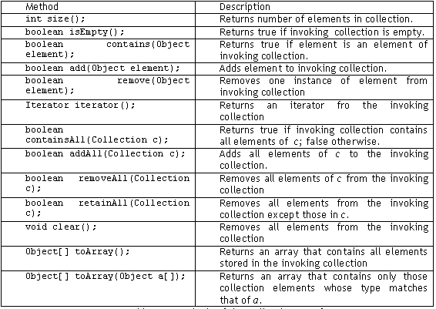
9.2: Collection Interfaces Collection Interface methods
Notes:
Collection Interface Methods:
The Collection Interface is the foundation on which the collection framework is built. It declares the core methods that all collections will have. Some of these methods are summarized in the table given in the above slide.
The bulk operations perform some operation on an entire Collection in a single shot. They are done through the following methods, namely: containsAll(), addAll(), removeAll(), retainAll(), clear().

Slide 10
Lab
Lab 7: Collections

Slide 11
Summary
The various Collection classes and Interfaces

Slide 12
Review Question
Question 1:Collections Framework consists which of the following parts?
Core Interfaces
Concrete Implementation
Algorithms such as searching and sorting
All of the mentioned
Question 2:_________interface is a Map that maintains its mappings in ascending key order.
Set
SortedSet
SortedMap
Queue

